Slide 1
Processes Lesson 1
David Liu
Fall 2021, Spring 2022

Slide 2
Learning Outcomes
Identify the separate components of a process and illustrate how they are represented and scheduled in an operating system.
Describe how processes are created and terminated in an operating system, including developing programs using the appropriate system calls that perform these operations.
Describe and contrast interprocess communication using shared memory and message passing.
Design programs that uses pipes and POSIX shared memory to perform interprocess communication.
Describe client-server communication using sockets and remote procedure calls.
Design kernel modules that interact with the Linux operating system.

Slide 3
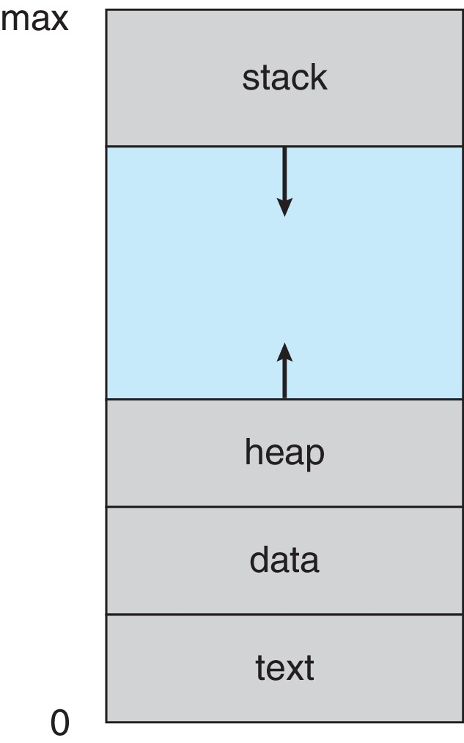
What is a Process?
Main memory
Process – a program in execution; process execution must progress in sequential fashion
text section
data
stack
Function parameters, return addresses, local variables
Heap
Dynamically allocated memory
program counter
Processor registers
CPU Activities

Slide 4
Shared Program
Multiple processes may execute the same program at the same time
How can it be done?

Slide 5
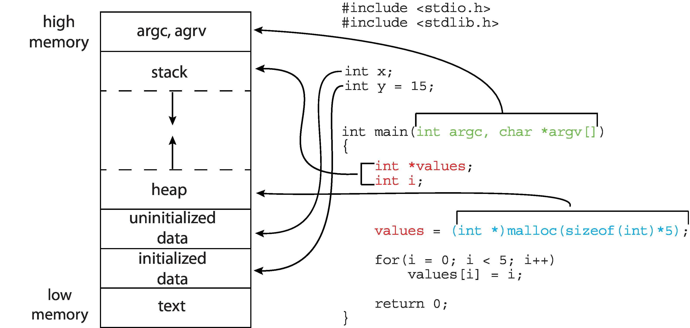
C Program in Memory

Slide 6

Process State Diagram

Slide 7
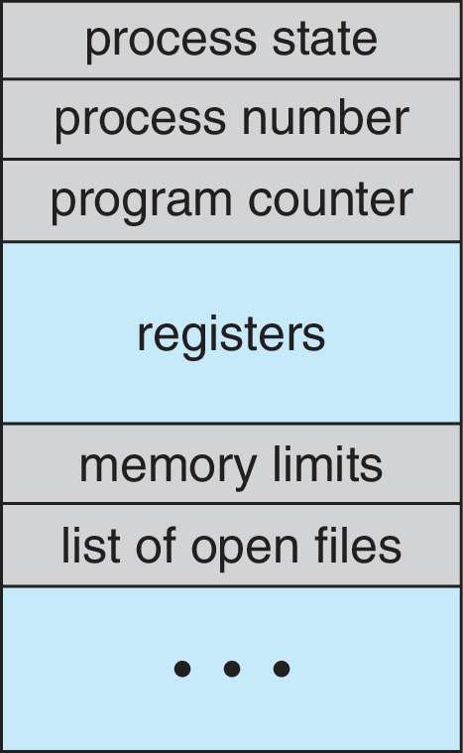
Process Control Block (PCB)
Process state
Program counter – location of instruction to next execute
CPU registers – contents of all process-centric registers
CPU scheduling information- priorities, scheduling queue pointers
Memory-management information – memory allocated to the process
Accounting information – CPU used, clock time elapsed since start, time limits
I/O status information – I/O devices allocated to process, list of open files

Slide 8
OS: A Resource Manager
What resources
CPU
Memory
I/O

Slide 9
OS: A Control Program
How a process is tracked?
How a process is scheduled and managed?

Slide 10
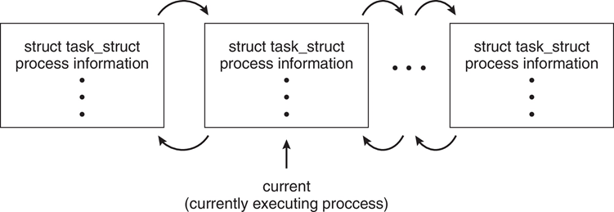
Process in Linux
Task_struct for both process and thread
Active Process Double linked List

Slide 11
Process Scheduling Purpose
Multiprogramming: Maximize CPU usage
Time sharing: user interaction

Slide 12
Degree of Multiprogramming
# of processes currently in memory
Section 3.2.

Slide 13
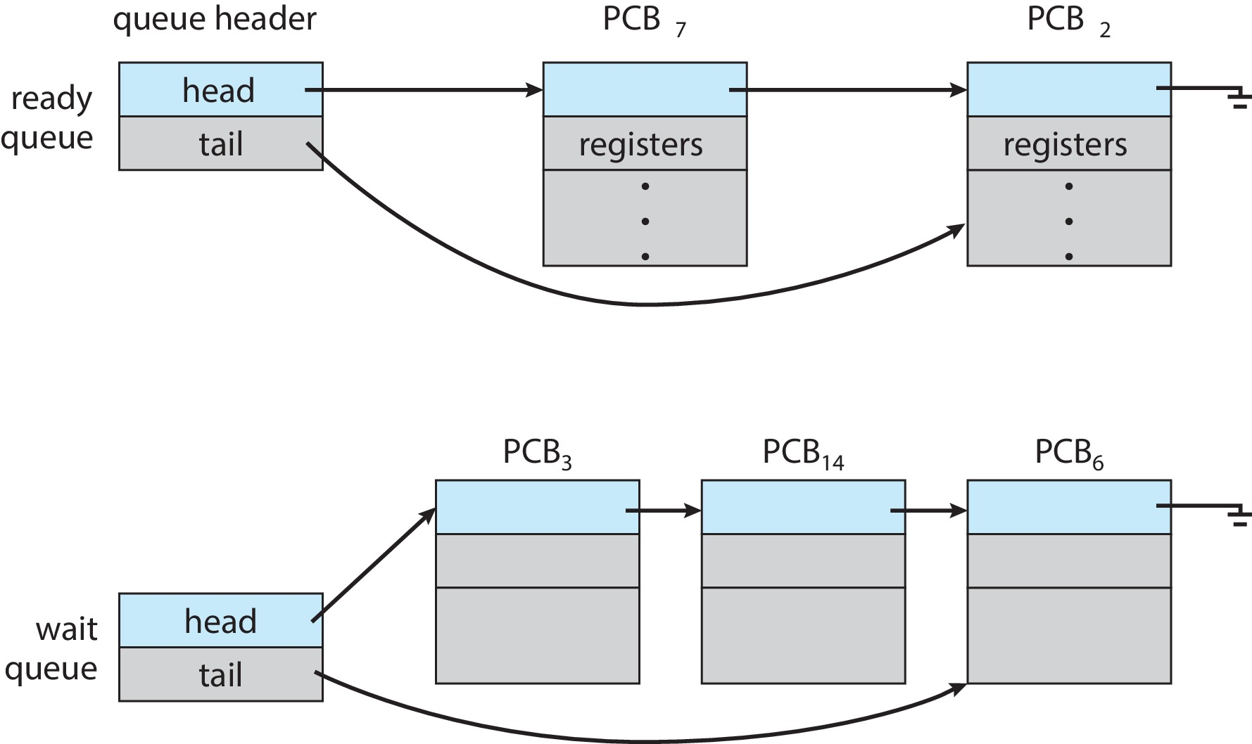

Ready and Waiting Queues

Slide 14
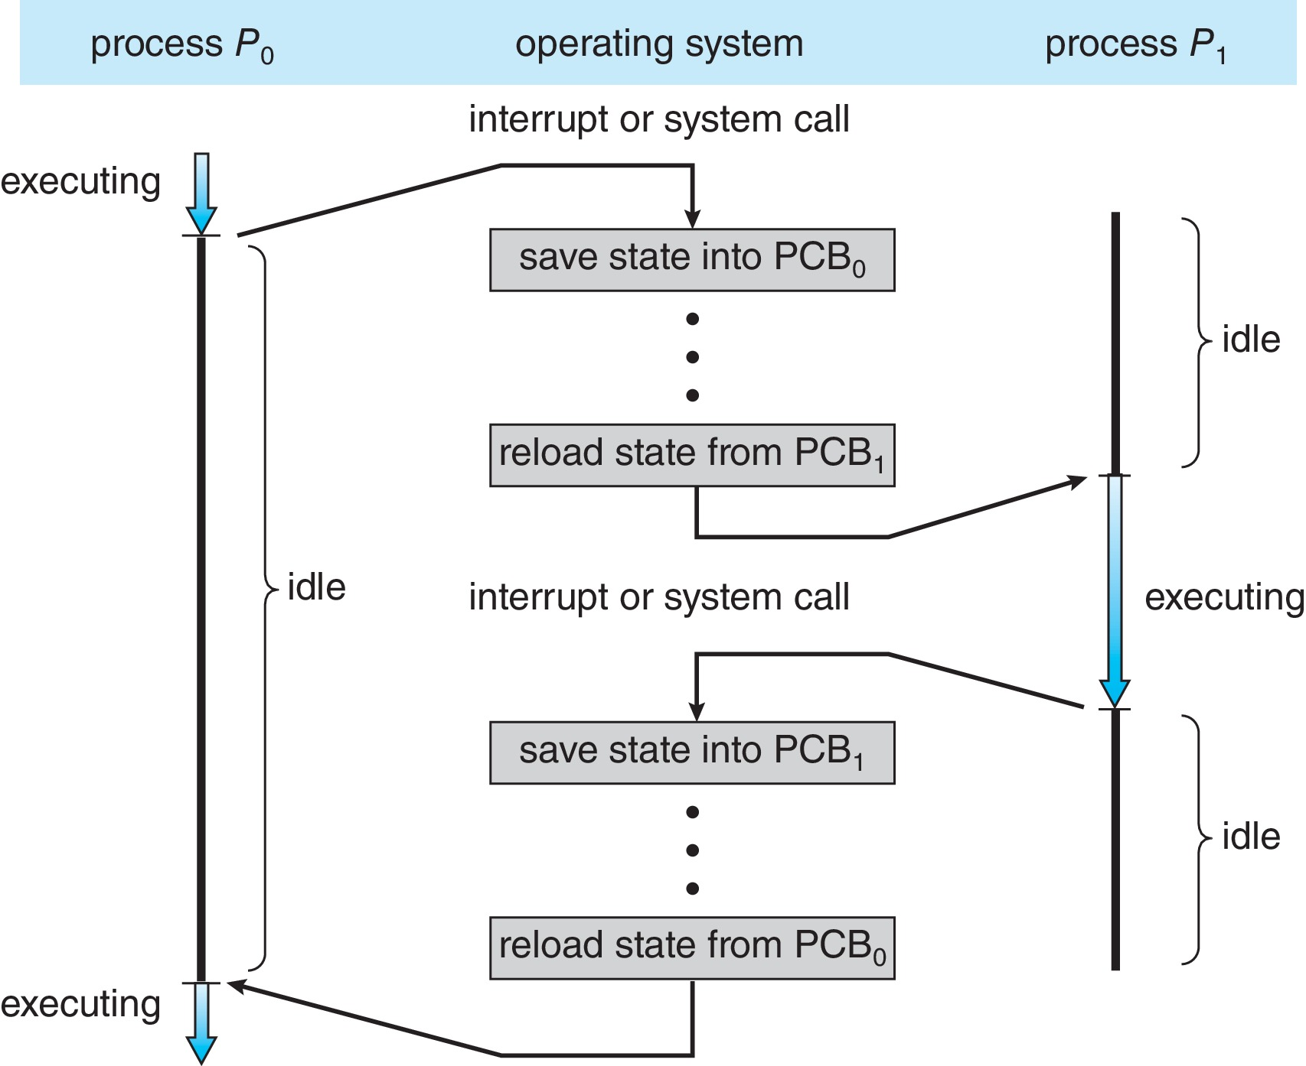
Context Switch
CPU switches from one process to another

Slide 15
Context Switch
Save state of replaced process in PCB
Load saved state of the new process
Shorting switch time is essential
Hardware support
Multiple sets of registers to rescue

Slide 16
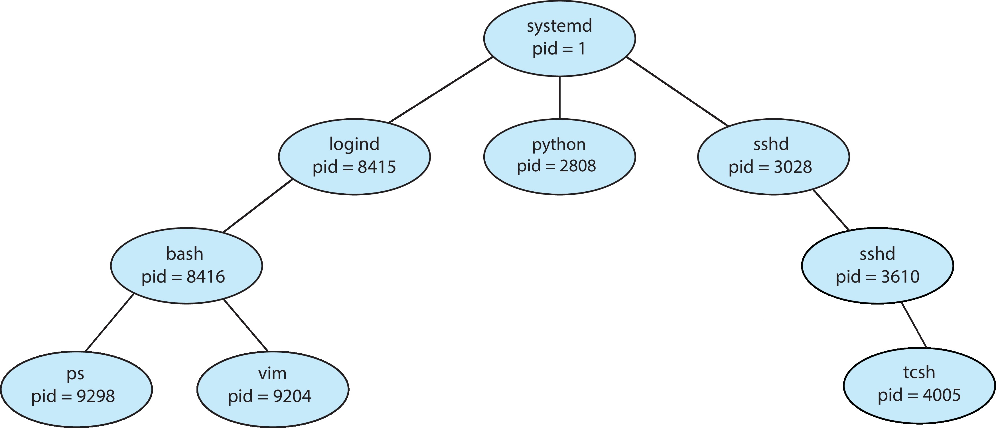
Process Creation

Slide 17
Parent and Child Processes
Resource Sharing Option
All resources
Subset of parent resource
No sharing
Execution Options
Execute concurrently
Parent wait until children terminate

Slide 18
Parent and Child Processes
Address space (main memory)
Duplicate parent’s in a new location in memory
Load a new program

Slide 19
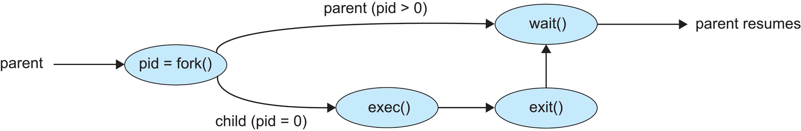
UNIX Process Creation
fork ()
exec ()
wait()

Slide 20

C Programming
fork creates a child process
Parent memory address space
pid = new created child process id
Child memory address space
pid = 0
How child finds its own id?
New program may be loaded
Question
What is the pid value in parent memory space and child memory space?
What are C functions to get Process ID and Parent Process ID?

Slide 21
Process Termination
Self terminate: exit()
Terminated by parent: abort
Allocated resources exceeded
child’s task not required
Terminated by OS
Parent termites

Slide 22
Zombie and Orphan Child Process
Zombie
Child process terminates, parent has not called wait (may be later)
Orphan
Parent terminated, not waiting for child

Slide 23
Process State Diagram

